Slide 1

Computer Organization and Assembly Language
Week 2
Instructor: Aqsa Safdar

Slide 2
Overview
Definition of ISA
Role of ISA in computer organization
Hardware–software relationship
MIPS architecture overview
RISC vs CISC
MIPS instruction formats (R, I, J)

Slide 3
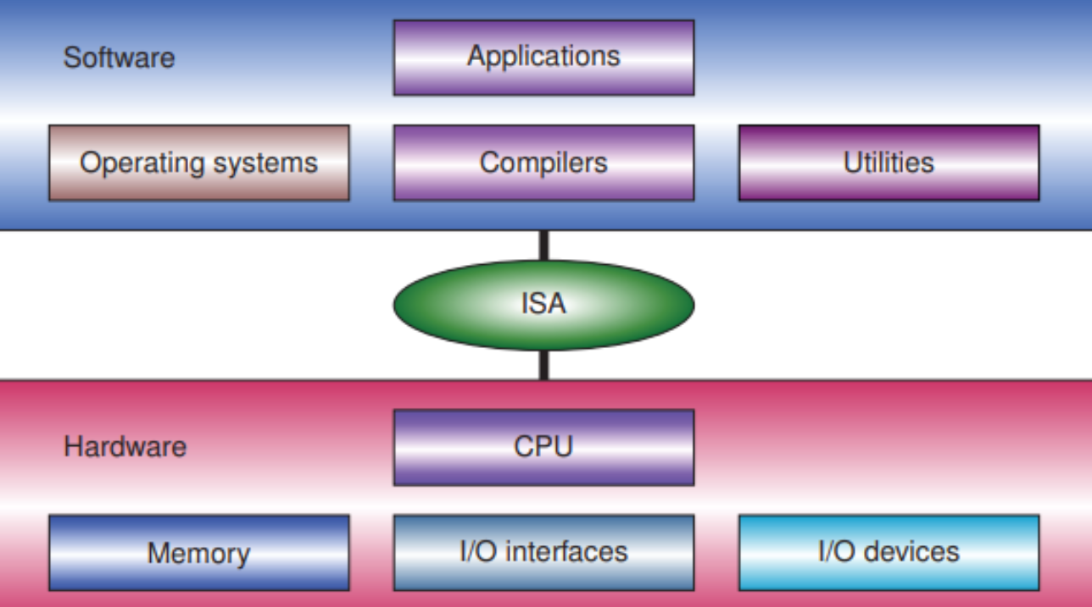
Instruction Set Architecture (ISA)
The set of instructions and rules that define how software communicates with computer hardware.
ISA is like the communication language between the brain and body, allowing software to control computer hardware.
ISA defines:
Supported instructions (add, load, store, jump, etc.)
Registers available in the processor
Data types (byte, word, etc.)
Addressing modes
Memory access methods
Example
High-level code: a = b + c
MIPS ISA instruction:
add $t0, $t1, $t2
ISA specifies how this operation is executed by hardware.

Slide 4
Contd….
ISA provides a standard interface between programs and hardware.
Benefits:
Software compatibility across processors
Hardware independence
Efficient instruction execution
Example:
Programs written for MIPS ISA can run on different MIPS processors.
ISA is the interface between software and hardware because software uses ISA instructions and the hardware is designed to execute those instructions
Notes:
ISA is the interface between software and hardware because software uses ISA instructions and the hardware is designed to execute those instructions

Slide 5
Contd…
ISA acts as the bridge between architecture and organization. It determines:
Instruction formats
Register usage
Memory addressing
So the ISA (Instruction Set Architecture) defines what the computer can do from the programmer’s point of view.
Computer organization then implements
these using:
Datapath → the path through which data moves inside the CPU
Control Unit → controls and coordinates operations
ALU (Arithmetic Logic Unit) → performs arithmetic and logical operations

Slide 6
Why ISA is Important
ISA acts as a bridge between architecture and organization:
ISA defines what operations are possible
Computer organization defines how those operations are carried out in hardware

Slide 7
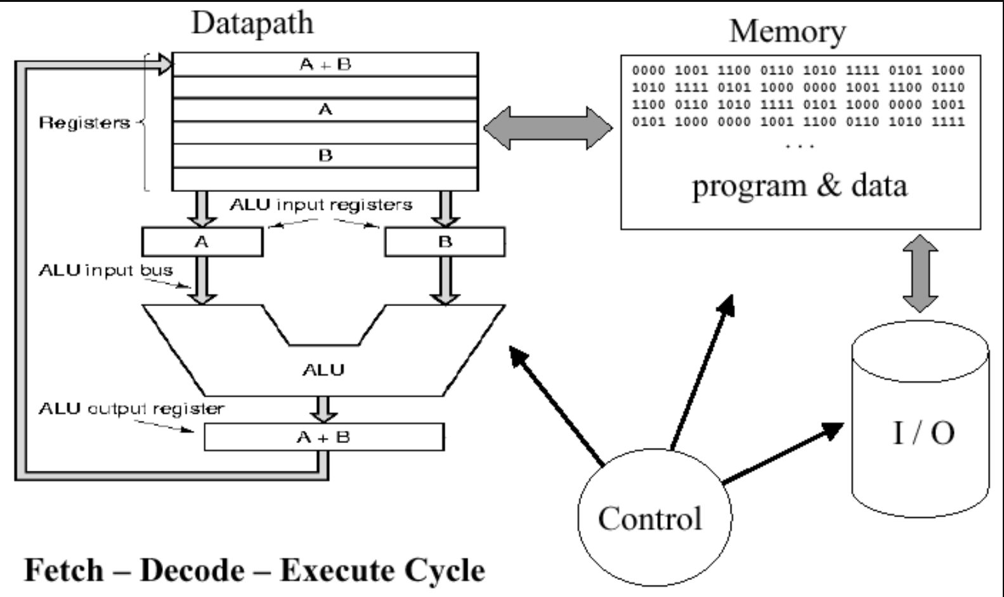

Slide 8
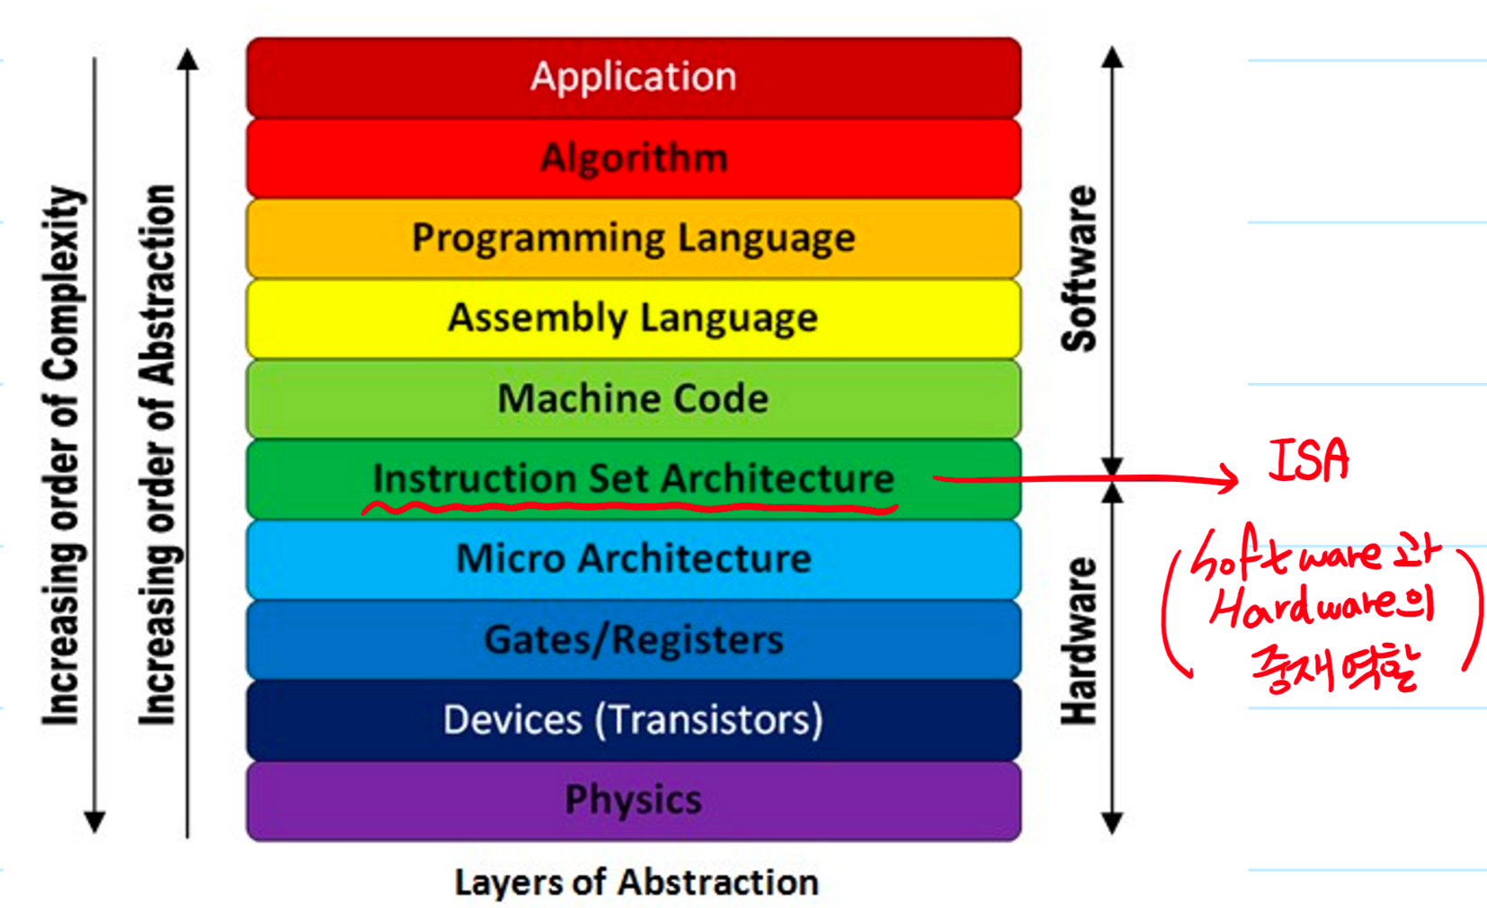
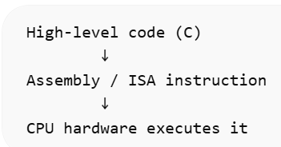
Programs written in high-level languages are translated into ISA instructions.
Example (C code)
x = y + z
Assembly (MIPS)
add $t0, $t1, $t2
$t1 contains y
$t2 contains z
$t0 Will store y + z
Hardware executes this
instruction.

Slide 9
Computer System Equivalent
Human Body | Computer System
Brain | CPU
Nervous system | Instruction Set Architecture (ISA)
Muscles/organs | Hardware components (ALU, registers, memory)
Command from brain | Program instruction
Action | Instruction execution

Slide 10
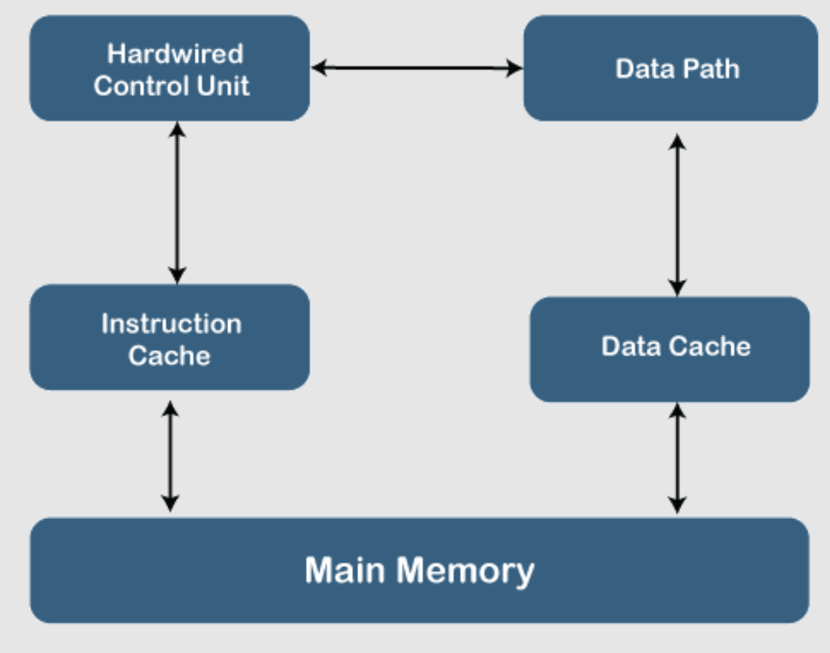
RISC (Reduced Instruction Set Computer)
Simple instructions
Fixed instruction length
Fast execution
Load/store architecture
Example processors:
MIPS
ARM
RISC-V

Slide 11
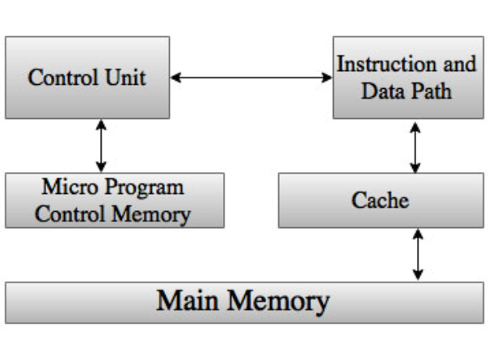
CISC (Complex Instruction Set Architecture)
Complex instructions
Variable instruction length
More addressing modes
Example processors:
Intel x86
AMD processors

Slide 12
RISC vs CISC
Feature | RISC | CISC
Instruction complexity | Simple | Complex
Instruction length | Fixed | Variable
Execution speed | Faster | Slower
Example | MIPS | x86

Slide 13
RISC vs CISC
Feature | CISC (Complex Instruction Set Computer) | RISC (Reduced Instruction Set Computer)
Definition | Complex Instruction Set Computer | Reduced Instruction Set Computer
Number of Instructions | Large number of instructions | Fewer number of instructions
Instruction Format | Variable length instruction format | Fixed length instruction format
Addressing Modes | Large number of addressing modes | Few addressing modes
Cost | Higher cost | Lower cost
Processing Power | More powerful instructions | Less powerful individual instructions
Instruction Execution | Multiple clock cycles per instruction | Usually single clock cycle per instruction
Memory Access | Instructions can directly manipulate memory | Operations performed mainly in registers
Control Unit | Microprogrammed control unit | Hardwired control unit
Examples | Intel x86, Motorola 68000, Mainframe processors | MIPS, ARM, SPARC, Fujitsu

Slide 14
MIPS
MIPS stands for Microprocessor without Interlocked Pipeline Stages
Key features:
RISC architecture
Simple instruction format
Load/store architecture:
Fixed instruction length (32 bits)
Notes:
In MIPS:
ALU operations work only on registers
Memory cannot be used directly in arithmetic operations
So data must first be loaded from memory to registers, then the ALU performs operations.

Slide 15
Common Registers in MIPS
Register | Purpose
$t0–$t9 | temporary
$s0–$s7 | saved
$zero | special register in MIPS that always holds the value 0.
$ra | return address

Slide 16
Instruction Formats in MIPS
What is an Instruction Format?
An instruction format defines the layout of bits within an instruction.
It specifies:
Operation to perform
Source operands
Destination operand
Immediate values or addresses

Slide 17
MIPS
MIPS follows Load/Store architecture. Only load and store instructions access memory
Arithmetic operations use registers only
Example:
lw $t0, 0($t1)
add $t2, $t0, $t3
sw $t2, 0($t1)
Steps:
Load value from memory
Perform computation
Store result back to memory
Notes:
In MIPS:
ALU operations work only on registers
Memory cannot be used directly in arithmetic operations
So data must first be loaded from memory to registers, then the ALU performs operations.

Slide 18
MIPS Instruction Formats
Each MIPS instruction has 32 bits.
Three main formats:
R-type (Register)
I-type (Immediate)
J-type (Jump)
MIPS Instruction (32 bits) |---- R-Type |---- I-Type |---- J-Type

Slide 19
R- Type
Used for register-to-register operations. That means:
Data is taken from registers
Operation is performed in ALU
Result is stored back in a register
Example:
add $t0, $t1, $t2
Meaning:
$t0 = $t1 + $t2
Format
| opcode | register source | register target | register destination | shamt | funct |
Suggested Diagram
|6|5|5|5|5|6| opcode rs rt rd shamt funct

Slide 20
R- Type
Field | Bits | Purpose
opcode | 6 | Defines instruction type (for R-type usually 000000)
rs | 5 | First source register
rt | 5 | Second source register
rd | 5 | Destination register
shamt | 5 | Shift amount (used in shift instructions)
funct | 6 | Specifies the exact operation (add, sub, and, etc.)
Notes:
Opcode → Arithmetic instruction
Funct → ADD / SUB / AND

Slide 21

I-Type
Used for:
memory access with offset
immediate values
branch instructions
Example:
lw $t0, 4($t1)
Meaning: Load value from memory.
Format

Slide 22
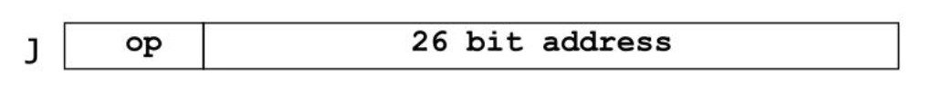
J- Type
Used for jump instructions.
Example:
j loop
j 0x00400010
Meaning:
Jump to instruction labeled loop.
Format
| opcode | address |
opcode (6 bits) → tells the CPU it’s a jump instruction
address (26 bits) → target address to jump to

Slide 23
Example
Field | Value
opcode | add
rs | $t1
rt | $t2
rd | $t0
Instruction:
add $t0, $t1, $t2
This tells the CPU:
$t0 = $t1 + $t2

Slide 24
Opcode (Operation Code)
Size: 6 bits
Purpose: Tells the processor what type of instruction it is.
In R-format instructions, the opcode is usually 000000.
Example:
add $t0, $t1, $t2
Opcode = 000000
This indicates that the exact operation will be determined by the funct field.

Slide 25
rs (Source Register)
Size: 5 bits
Purpose: Specifies the first source register containing data.
Example:
add $t0, $t1, $t2
Here:
rs = $t1
Meaning: take the first operand from register $t1.

Slide 26
rt (Target Register)
Size: 5 bits
Purpose: Specifies the second source register.
Example:
add $t0, $t1, $t2
Here:
rt = $t2
Meaning: take the second operand from register $t2.

Slide 27
rd (Destination Register)
Size: 5 bits
Purpose: Specifies the register where the result will be stored.
Example:
add $t0, $t1, $t2
Here:
rd = $t0
Meaning: store the result in $t0.

Slide 28
shamt (Shift Amount)
Size: 5 bits
Purpose: Used only for shift instructions to indicate how many positions to shift.
Example:
sll $t0, $t1, 2
Here:
shamt = 2
Meaning:
shift the value in $t1 left by 2 bits and result store in $t0.
For most other instructions (like add, sub), shamt = 00000.

Slide 29
funct (Function Code)
Instruction | funct value
add | 100000
sub | 100010
and | 100100
or | 100101
slt | 101010
Size: 6 bits
Purpose: Specifies the exact operation when opcode = 000000.
Examples:
So the processor checks the funct field to know which operation to perform.

Slide 30
Example
Field | Meaning
opcode | 000000
rs | $t1
rt | $t2
rd | $t0
shamt | 00000
Instruction:
add $t0, $t1, $t2

Slide 31
Immediate Field in I-Type Format
I-Type Format
| opcode | rs | rt | immediate | 6 bits 5 5 16 bits
What is Immediate?
The immediate field is a 16-bit constant value that is included directly inside the instruction.
Instead of taking the value from another register, the processor uses this constant value during execution.
Purpose
The immediate value is used for:
arithmetic operations
memory addressing
branch instructions

Slide 32
Example 1: Arithmetic Immediate
addi $t0, $t1, 5
Meaning:
$t0 = $t1 + 5
Here:
rs = $t1
rt = $t0
immediate = 5
So the processor adds 5 directly to the value in $t1.

Slide 33
Example 2: Memory Access
lw $t0, 8($t1)
Meaning:
$t0 = Memory[$t1 + 8]
Here:
$t1 holds the base address
8 is the immediate offset
The CPU calculates the final memory address by:
base register + immediate value

Slide 34
Address Field in J-Type Instruction
What is the Address Field?
The address field is a 26-bit value used to specify the target location to jump to in the program.
It tells the processor where the next instruction should come from.
Purpose
It is used for jump instructions.
Examples:
j
jal

Slide 35
Example
j loop
Meaning:
Jump to the instruction labeled loop.
If the address stored in loop is:
00400040
The processor updates the Program Counter (PC) to that location.

Slide 36
How the Jump Address is Calculated
The 26-bit address is not the full address, so the processor combines it with the upper bits of the Program Counter (PC) to create the final 32-bit address.
Simplified idea:
Final Address = PC upper bits + 26-bit address + 00
(The 00 is added because instructions are word aligned. (every instruction is 4 bytes, so the last 2 bits are always 0).)
Notes:
In MIPS, each instruction is 4 bytes (1 word = 4 bytes).
This means the memory address of any instruction is divisible by 4

Slide 37
Summary
ISA defines communication between hardware and software
MIPS is a RISC architecture
Load/store model used in MIPS
Instruction formats include R, I, and J types
ISA acts as the bridge between programs and hardware

